Slide 1









NTU CANTEEN
HELPER
~ GUAT KWAN ~ CHI HUI ~ LAN

Slide 2

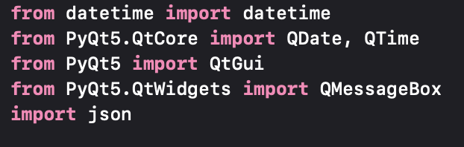


01. External Library and Modules
Modules used:
Datetime
PyQt
json

Slide 3
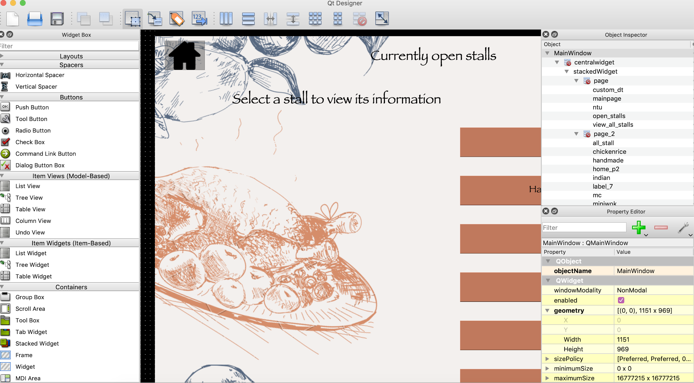
01. External Library and Modules
Why PyQt?
Simplicity
Ease of generating UI file using PyQt5 designer

Slide 4


Assessment Criteria

Slide 5
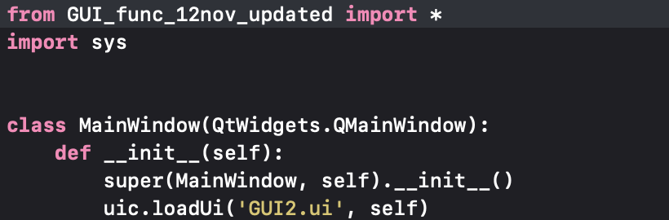
02.Program Organisation
1 UI file
GUI2.ui
2 python files
GUI_func.py
GUI_main.py
2 Json file
opr_hr_db.json
menu_db.json
Use of 5 files
Notes:
make a joke. Its suitable for stupid people like us
UI file generated directly from designer
importing functions into main
Don't have to make change to code

Slide 6
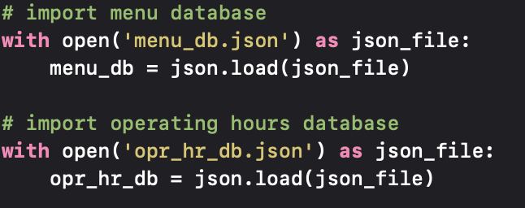




03.File Operation
Nested Dictionaries use to store data
Databases stored as Json File
Why Json?
Simplicity of json
Straightforward Syntax
Easy to read and write
Language independent

Slide 7
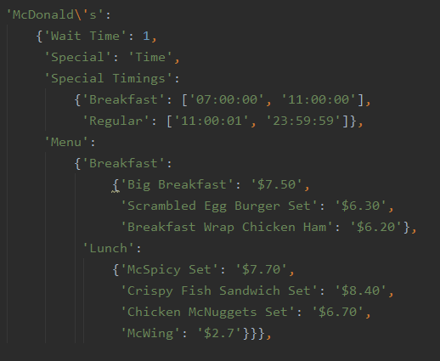
04. Dictionary and List
Use of list to store start and end times
Dictionary of menu

Slide 8
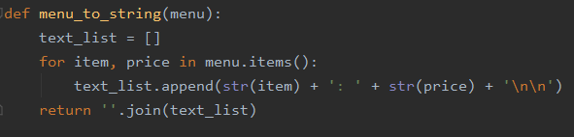
05. String Operations/Functions
String concatenation
using .join() method

Slide 9
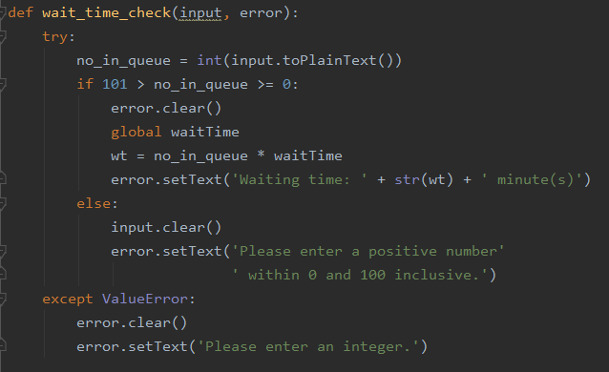
06. Exception Handling
Try converting user input into int
Display waiting time
Out-of-range error
Incorrect data type error

Slide 10
07. Clarity and Comprehensibility
Segmentation
Functions are placed under different categories based on their purpose
E.g. Date and time functions, data retrieving functions, GUI functions

Slide 11
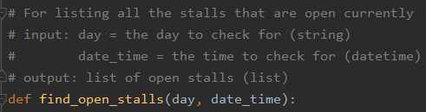
07. Clarity and Comprehensibility
Comments and Documentation
Brief description of function
Description of output
Description of inputs

Slide 12
Main page
08. FlowChart
All stalls
Currently Open Stalls
Custom date and time
Select a stall
Select a stall
Operating Hours
Operating Hours
Display current menu
Calculate waiting time
Display all menus
Calculate waiting time

Slide 13



09. LIVE DEMO

Slide 14



10. Contributions
GUAT KWAN
LAN
CHI HUI
Allow to check operating hours of all store
Display informations and menu based on current date and time
Overall Algorithm and flow of program
Store and display stall menus
Store and display stall information based on user defined date and time
GUI
Store and display stall menu
Calculate estimated waiting time for stall by asking user to enter the number of people in queue
GUI

Slide 15

Q&A

Slide 16
THANK YOU

